Slide 1
Practical tools for Quakers
Notes:
These including campus resources, support, and treatment options

Slide 2
History of Wellness at Penn
Notes:
To many of you the logos you see on the screen are very familiar
the Student Health Service
CAPS which stands for counseling and psychological services
These entities have been providing services to our students for many years
And in 2021 these entities, who had been operating as siloed organizations, were integrated as a single entity under a new Wellness umbrella
what I want to show you next is what else falls under our Wellness umbrella and
how we are going to revitalize and reorganize these services under new structures in order to better meet your needs

Slide 3
New Pillars of Wellness
Notes:
While we are there to take care of your when you need help, we also want to be proactive and give you the tools you need to succeed. That’s why we reorganized our Wellness efforts under two pillars:
Student Health and Counseling and
Public Health and well-being
both organizational pillars operate in an integrated fashion
to provide services to segments of the campus community

Slide 4
Vision, Mission, & Core Values
Notes:
We will work to fulfill this vision by infusing Wellness across its eight domains, illustrated here on the wellness wheel, throughout the Penn experience through inclusive innovative and impactful initiatives you will recognize the words inclusive innovative and impactful as they mirror our campus-wide Penn Compact.
All of our efforts are fueled by
compassion
accessibility
respect and
empowerment
And grounded in collaboration

Slide 5
Caring for Students During Their Academic Journey
Notes:
Let's begin with Student Health and Counseling
This organization brings together clinicians to cater to your (our students’) physical and emotional needs
as they navigate their academic journey at Penn

Slide 6
Medical services
Student Health & Counseling
24/7 access and support
Allergy care
Gynecologic care
Immunization
Nutrition
Podiatry
Primary care
Sexual health
Sports medicine
Travel medicine
Notes:
*The majority of Wellness at Penn services are covered by your student fees
-Visits to Student health are covered if you paid the clinical fee, check your bursar's bill to confirm you have paid the clinical fee (all full time students have)
-travel medicine and other visits may incur fees based on what happens in the appointment.
-Telehealth and in-person services are available

Slide 7
Counseling services
Student Health & Counseling
24/7 access and support
Drop-in services (Let’s Talk and on-site)
Individual therapy
Group therapy
Psychiatric medication
Referral and consultation services
All counseling services offered at Penn are covered by your student fees.
Notes:
We offer solution-oriented, short-term care that is tailored to fit each student’s unique needs
Our services are free and confidential
Mental health services are offered in-person and may be also be offered virtually in some circumstances
You can access services by calling our main number (24/7). If you would like to talk to someone right away, press #1. If you want to make an appointment, press 2. You can also come in and meet with someone during regular business hours. Nothing is too big or too small. -Please remember, we are always available for urgent needs.
Please continue to check out website for updates on hours and policies.

Slide 8
Creating a Community of Care
Notes:
Public health and wellbeing brings together various existing entities into a reorganized structure whose goal is to create a community of care
And this community extends beyond our student population to include faculty, staff and post-docs as well.
While student health and counseling has a very specific focus in caring for our well over 26,000 students
public health and wellbeing has a much much larger scope
As we've seen during COVID, to create a caring community, we must include everyone

Slide 9
Public Health & Wellbeing
Specialty Areas:
Infectious disease surveillance
Insurance and immunization compliance
Health policy
Health education and promotion
Wellbeing initiatives
Penn Farm
Notes:
-ALWAYS Call for help, that's why this policy is here
-This does not protect against other violations while intoxicated
Other types of violations while intoxicated (ex. vandalism, violence, harassment)
Potential Consequences include a referral to the Office of Student Compliance and legal charges
Lower-risk drinking in a college house
Alcohol or drugs being kept in a college house
Hosting parties with alcohol in a college house

Slide 10
Public Health & Wellbeing
Workshop Topics:
Substance use
Helping students in distress
Imposter syndrome
Mindfulness and meditation
Nutrition and physical activity
Sexual health
Sleep hygiene
Stress and self-care
Notes:
Our health educators offer a wide variety of workshops to give you the knowledge and skills to thrive during your academic journey

Slide 11
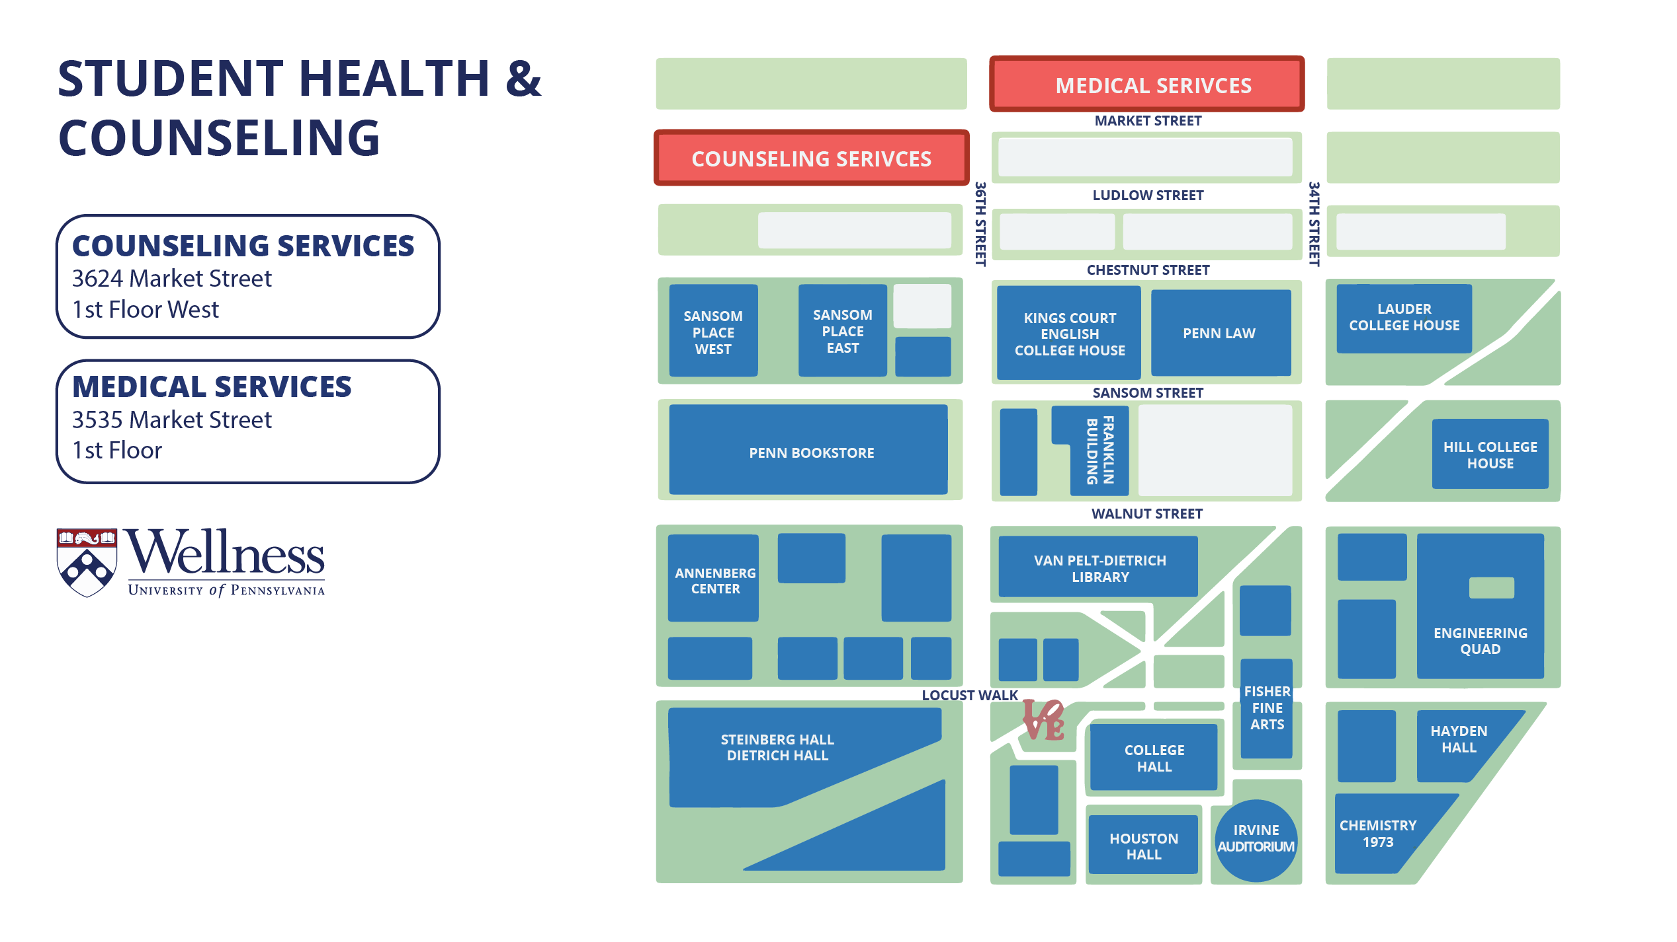
Visit us!
Notes:
Public Heath and Wellbeing, as well as Immunization and Insurance Compliance are both also in 3535, but on the Mezzanine level.

Slide 12
Follow us: @WellnessAtPenn @PennTogether
Student Health and Counseling: -- Medical services: 215-746-3535 (3535 Market Street, 1st Floor) -- Counseling services: 215-898-7021 (3624 Market Street, 1st Floor West)
Visit our Website: https://wellness.upenn.edu
Stay Connected!
Public Health and Wellbeing:
-- Immunization and Insurance Compliance: 215-746-4200
-- Public Health: 215-898-0300

Slide 13
Notes:
-Put these #s in your phone now!
-This is an important resource, especially if you are going out for the night and may be drinking

